Slide 1

MARKETING CAMPAIGN PERFORMANCE ANALYSIS
Practical Excel Data Analytics Project
Presented by: Nimca Wehliye
Course: Excel for Data Analysis • Microsoft Excel

Slide 2
1. Project Overview
What the project is designed to answer
• Analyze marketing campaign performance using Excel.
• Evaluate Budget, Leads and Conversions.
• Compare performance by Channel, Region and Year.
• Transform raw data into reliable business insights.
• Support management decisions with findings and recommendations.
RAW DATA
CLEAN
FORMULAS
PIVOTS
CHARTS
KPIs
SLICERS
DASHBOARD
FINDINGS

Slide 3
2. Dataset Introduction
Source: 20_Marketing sheet supplied in the course dataset workbook
300
7
293
7
Original records
Confirmed duplicates removed
Clean records
Original variables
Important variables
Campaign_ID • Start_Date • Channel • Region • Budget • Leads • Conversions
Purpose: measure campaign efficiency and identify the channels/regions that generate stronger conversion results.

Slide 4
3. Data Preparation & Cleaning
Cleaning was completed before analysis to protect the accuracy of totals and PivotTables
• Identified and removed 7 exact duplicate records.
• Standardized text using TRIM and case normalization.
• Filled missing categories with “Unknown” where appropriate.
• Filled missing numeric values using the median.
• Filled missing dates using the median date.
• Created derived fields: Year, Month, Conversion Rate and Cost metrics.
1 — Inspect
1
2
2 — Clean
3
3 — Validate
4
4 — Analyze

Slide 5
4. Excel Formula Analysis
The project demonstrates the required analytical functions
Basic
SUM • AVERAGE • COUNT • MIN • MAX
Conditional
SUMIF • COUNTIF • AVERAGEIF
Logical
IF • AND
Date
TODAY • YEAR • MONTH • DAY • NETWORKDAYS
Text
TRIM • UPPER • PROPER • SUBSTITUTE
Example: SUMIF calculates the total Budget for a selected Channel; IF classifies campaign performance using a conversion-rate threshold.

Slide 6
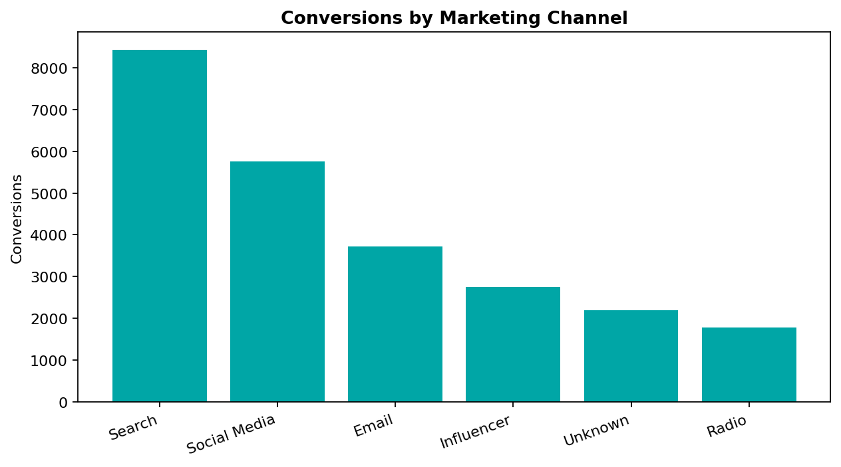
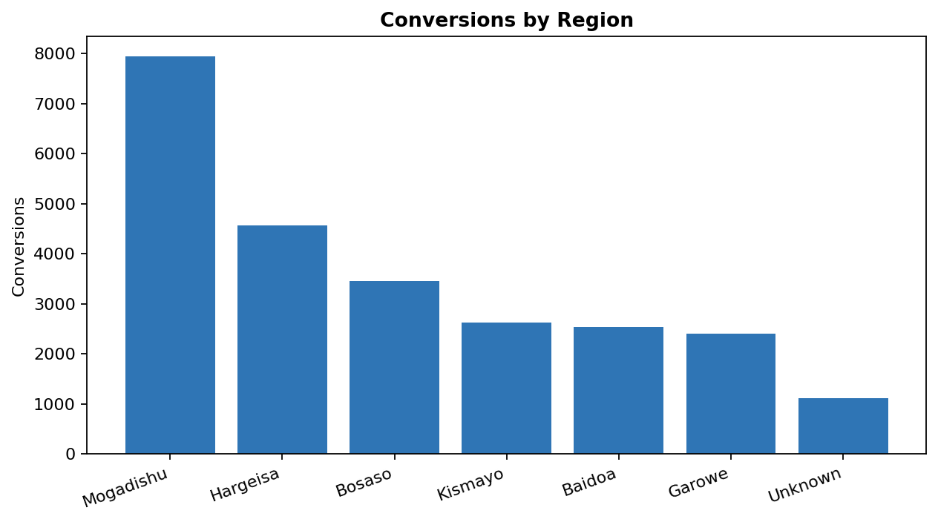
5. PivotTables & Data Visualization
Summaries make hundreds of records easier to compare
PivotTable areas: Rows • Columns • Values • Filters. Charts are built from summarized results rather than raw rows.

Slide 7
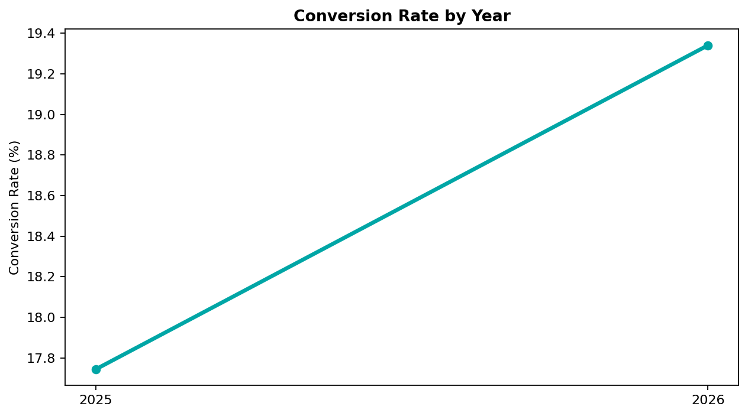
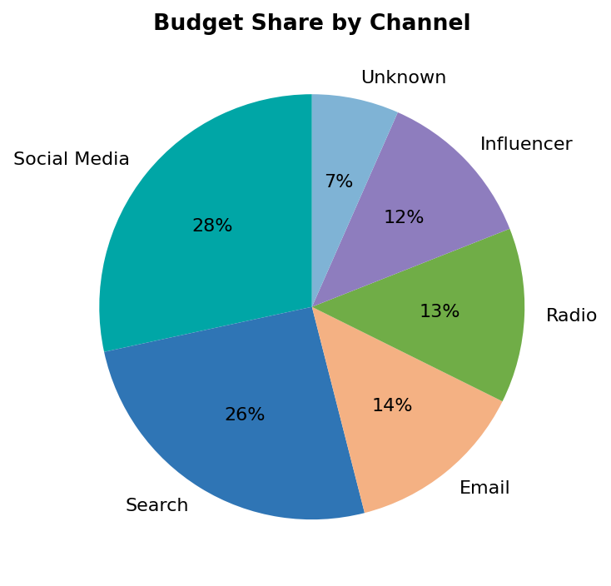
6. KPI Dashboard
Management can see the key numbers immediately
TOTAL BUDGET
TOTAL LEADS
TOTAL CONVERSIONS
CONVERSION RATE
$821,023
134,724
24,658
18.3%

Slide 8
7. Findings & Recommendations
Turning analysis into business decisions
• Search generated the highest conversion volume (8,434).
• Radio had the lowest conversion rate (10.7%) among channels.
• Bosaso recorded the strongest regional conversion rate (20.6%).
• The cleaned dataset contains 293 valid records after removing duplicates.
• Overall conversion rate is 18.3%.
• Gradually increase investment in Search while monitoring cost efficiency.
• Review Radio targeting, creative and conversion path.
• Replicate successful practices from Bosaso in other regions through controlled tests.

Slide 9
CONCLUSION
Raw Data → Clean Data → Formulas → PivotTables → Charts → KPIs → Slicers → Dashboards → Findings → Recommendations
The project demonstrates that Excel is not only for data entry — it is a tool for analysis and informed business decisions.
Thank you • Questions?

